Slide 1




ZOMATO ANALYsis

Slide 2
Project Name : Zomato Analysis
Group No: 2
Project Members :
Raghava Rao Putchakayala
Kalla Jayanthi Kumari
Bharath B Poojari
Awasthi Hrutik Chetankumar
Ketan Bajarang Yelavikar
Prajakta Balu Kunal
Margonda Sowmini
Shraddha Prakash Shivgan
Ankush Batt

Slide 3
Introduction
The Zomato dataset provides a comprehensive view of restaurant information, customer preferences, and operational metrics.
It includes details such as restaurant names, locations, cuisines, pricing, customer ratings, and service availability.
This data is crucial for understanding and optimizing various aspects of the Zomato platform, from enhancing user experience to improving restaurant performance and streamlining delivery operations.
By analyzing these insights, Zomato can make data-driven decisions to better serve its customers and restaurant partners, ultimately driving growth and efficiency in the competitive food delivery market. ​

Slide 4

STRATEGIC OBJECTIVE
The strategic objective of analyzing the Zomato dataset is to leverage data-driven insights to enhance customer satisfaction, optimize restaurant performance, and improve operational efficiency.
By examining customer preferences and behavior, Zomato aims to tailor marketing strategies and personalized recommendations.
Analyzing restaurant ratings and reviews helps identify areas for improvement and support partner restaurants in delivering better service. Additionally, insights into delivery logistics will streamline operations, reduce costs, and ensure timely deliveries.
Ultimately, this analysis aims to drive growth, increase market share, and maintain Zomato's competitive edge in the food delivery industry.

Slide 5

KPI’S
1. Build a country map table and currency map
2. Build a calendar table using the column datekey. A.Year B.Month no C.Monthfullname D.Quarter (Q1,Q2,Q3,Q4) E. Year month ( YYYY-MMM) F. Weekday no G.Weekday name H.Financial month
( April = FM1, may= FM2 …. march = FM12) I. Financial quarter ( quarters based on financial month)
3.Find the numbers of restaurants based on city and country.
4.Numbers of restaurants opening based on year , quarter , month
5. Count of restaurants based on average ratings
6. Create buckets based on average price of reasonable size and find out how many restaurants falls in each buckets 7.Percentage of restaurants based on "has_table_booking“
8.Percentage of restaurants based on "has_online_delivery"
9. Develop charts based on cuisines, city, ratings

Slide 6
EXCEL

Slide 7
DATA CLEANING
Accessing data with power query
Navigate to the data tab in excel.
Select "get data" and choose "from file."
Pick the excel workbook containing your data.
Upon selecting the file and clicking "ok," power query editor opens automatically.
We need to check all the column headers and data types.
We removed all duplicates from the datasets.
We removed unnecessary columns from the datasets to improve performance.

Slide 8
DATA CLEANING CONSTRAINTS
In the Power Query Editor, null values were replaced. North Indian, being the most repetitive category, was not used for replacement as it is irrelevant data.
Instead of that, we added the most related category like 'Pizza', which could skew the data analysis.
So, we opted to categorize these values as 'Others'. This approach ensures that the integrity of Zomato's data analysis remains unaffected by avoiding the influence of specific food types.
Instead of removing null values, which would result in data loss and impact analysis, we replaced them with related data.
This approach preserves the integrity of the dataset and ensures that the analysis remains comprehensive and accurate without compromising on data completeness.

Slide 9
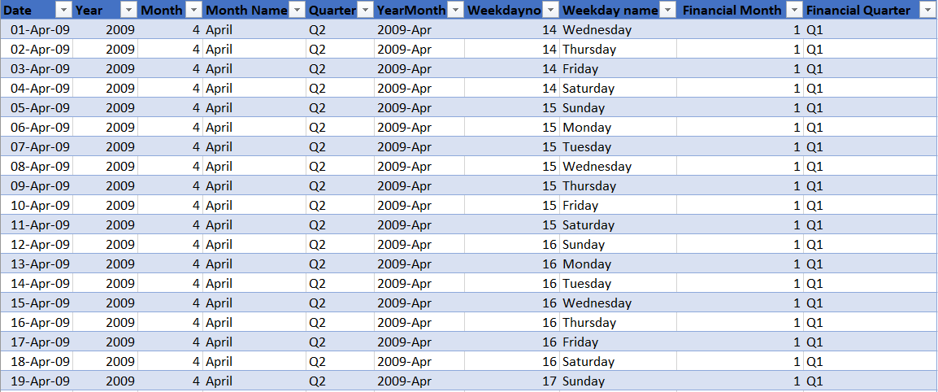
DATE TABLE
We created a date table in excel to facilitate further analysis of time-related data for enhanced time intelligence purposes.

Slide 10
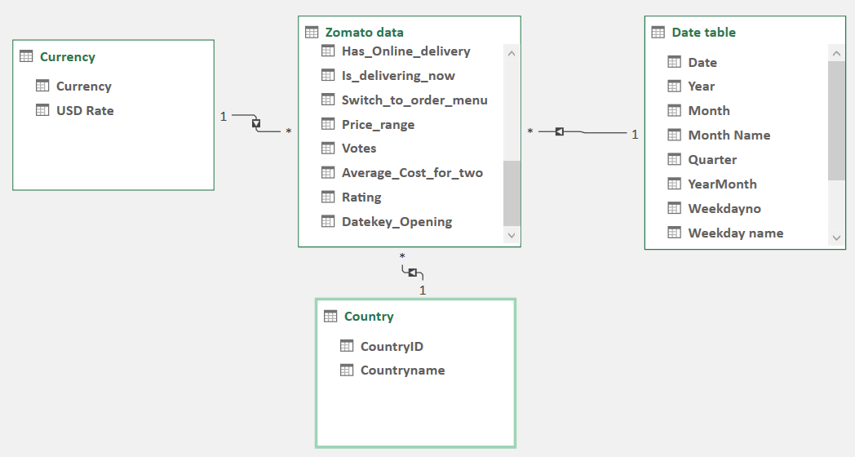
DATA MODELING

Slide 11
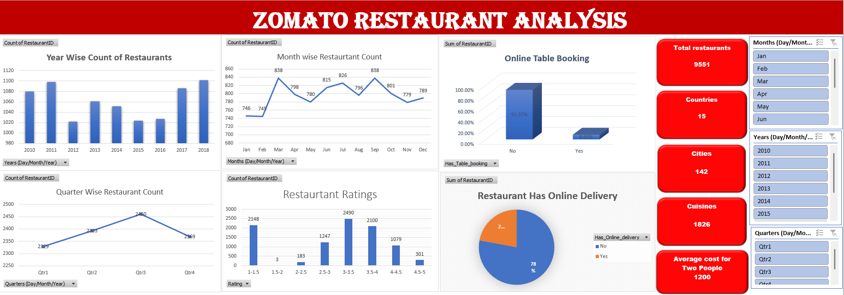

Slide 12
POWER BI

Slide 13
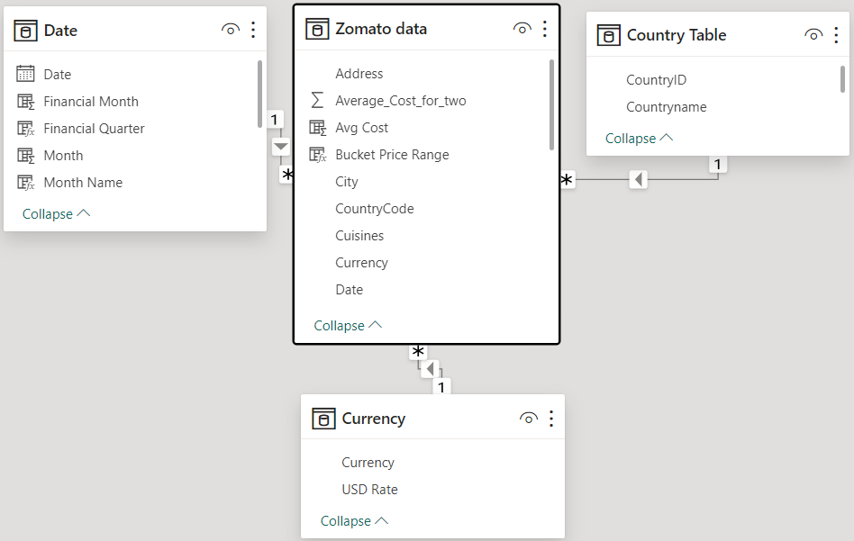
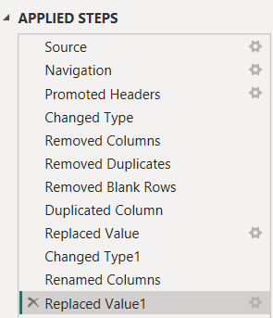
DATA CLEANING & MODELING

Slide 14
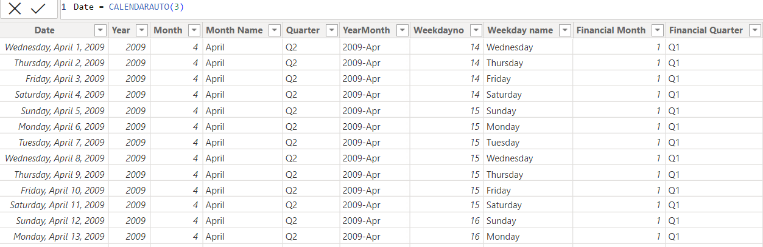
DATE TABLE USING DAX

Slide 15
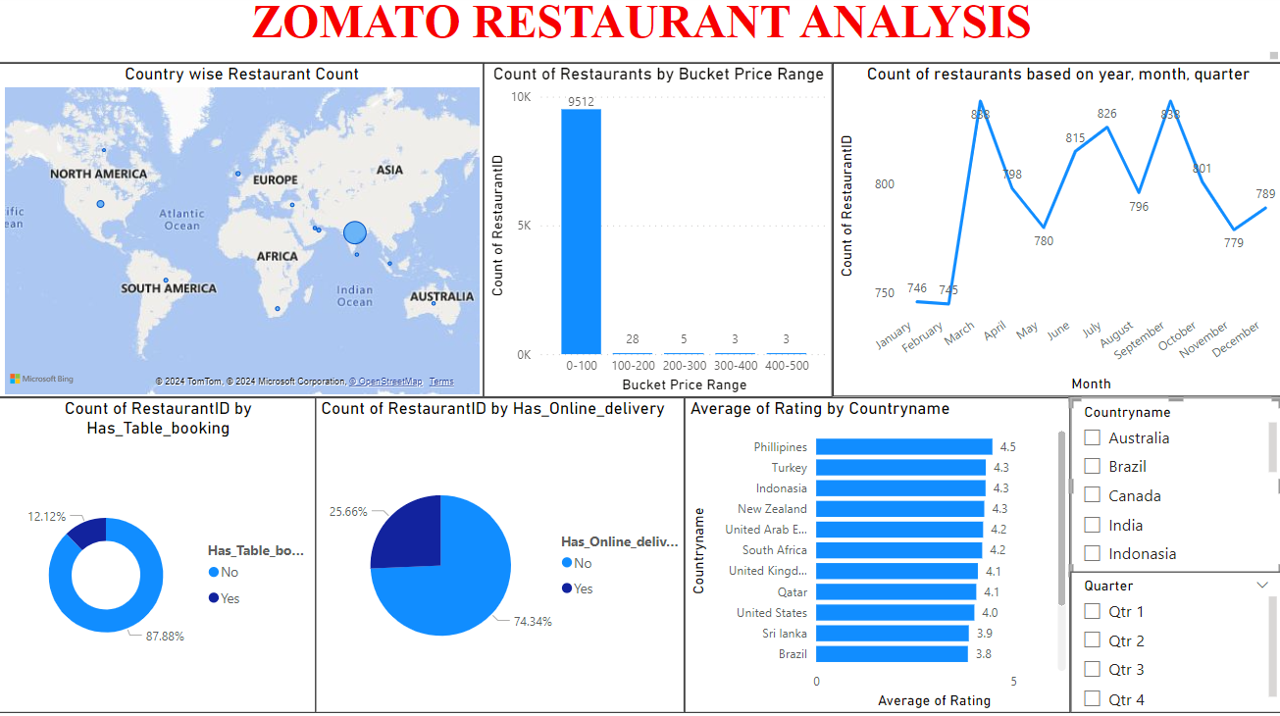

Slide 16
TABLEAU

Slide 17
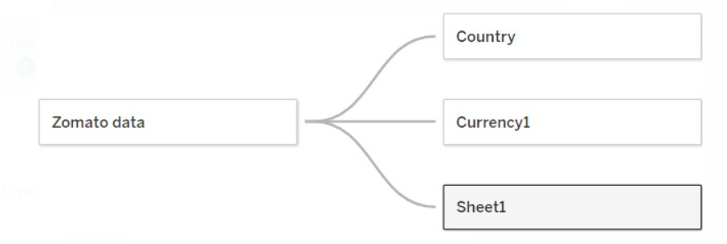
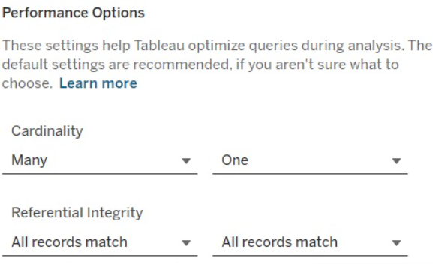
DATA MODELING

Slide 18
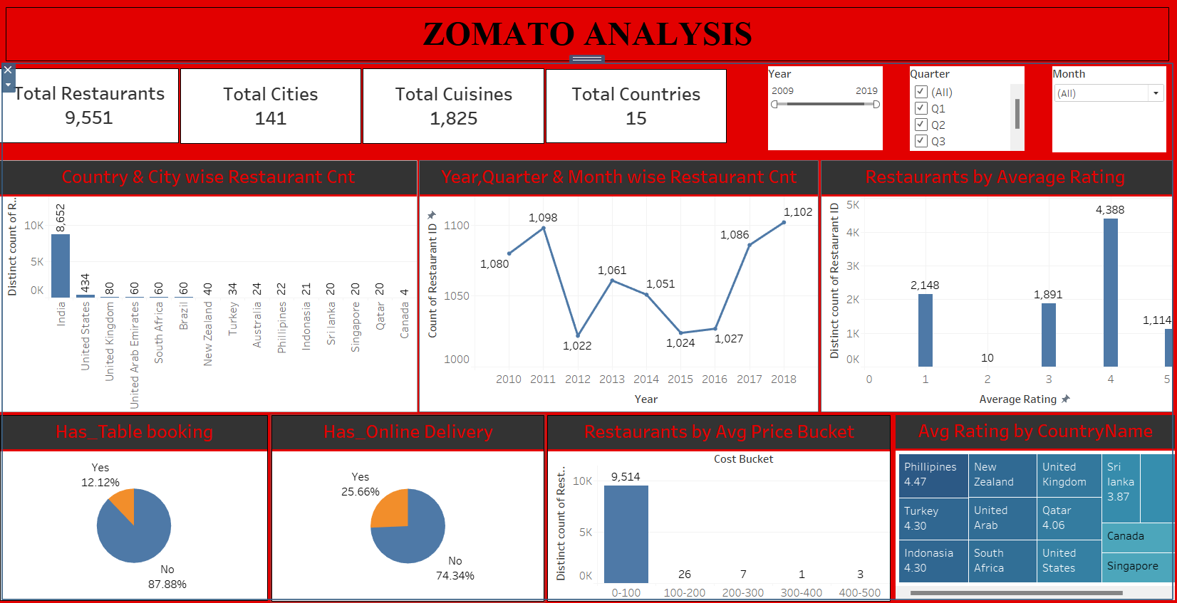

Slide 19
MYSQL

Slide 20
KPI’s
Country & Currency Mapping: Created CountryMap and CurrencyMap tables, inserted data, and set foreign key relationships.
Calendar Table: Built a calendar table extracting year, month, day, and custom financial metrics.
Restaurant Count by City/Country: Joined sheets on country codes and counted restaurants by city and country.
Restaurant Openings: Counted restaurant openings by year, quarter, and month, and ordered results accordingly.
Restaurant Rating Ranges: Categorized and counted restaurants based on rating ranges.
Restaurant Price Ranges: Created price buckets and counted restaurants in each range.
Table Booking Percentage: Calculated the percentage of restaurants with table bookings.
Online Delivery Percentage: Calculated the percentage of restaurants offering online delivery.
Restaurant Performance: Analyzed top restaurants by votes and ratings, and managed cuisine data splitting.

Slide 21
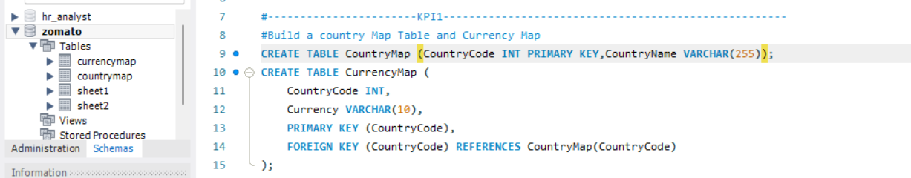
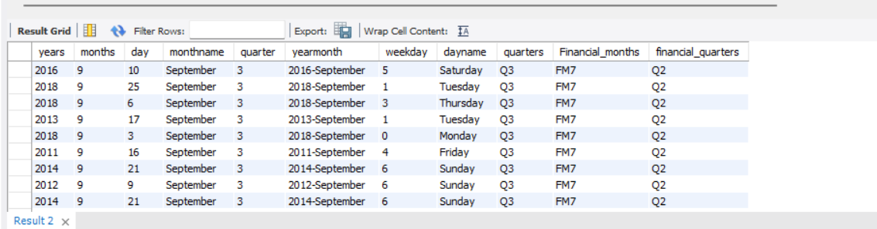
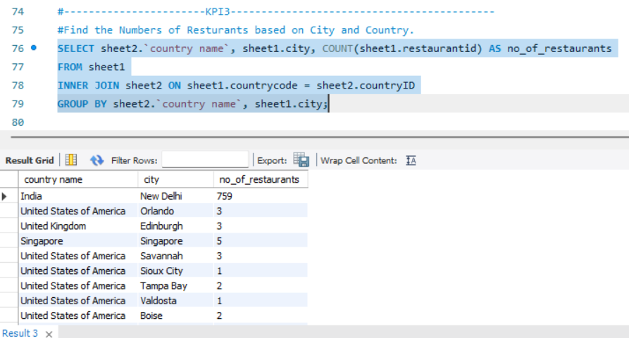
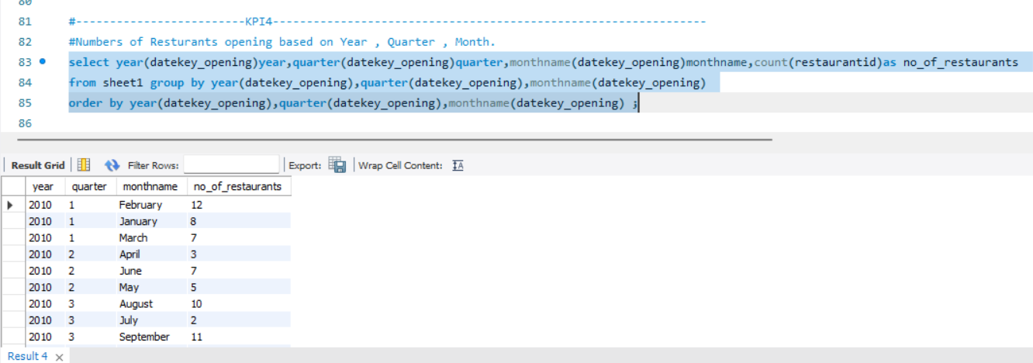

Slide 22
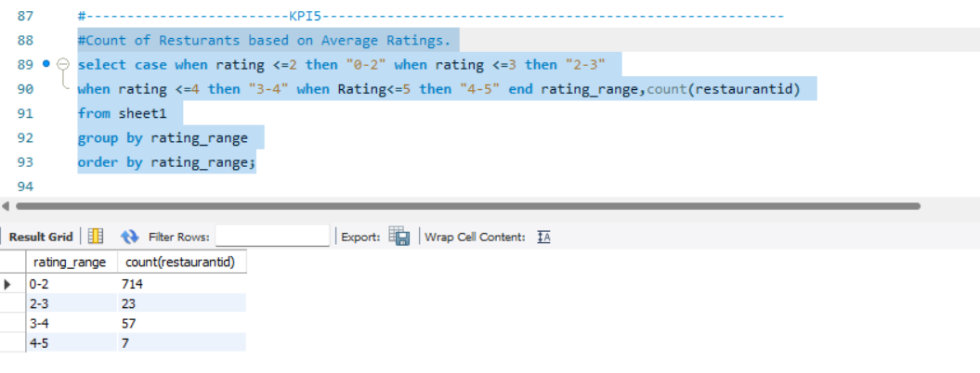
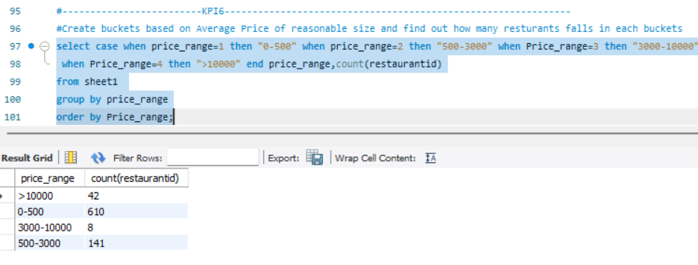
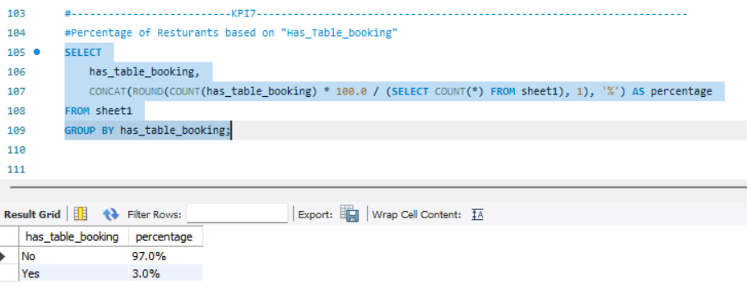
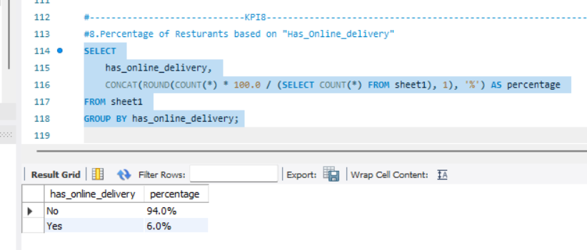

Slide 23
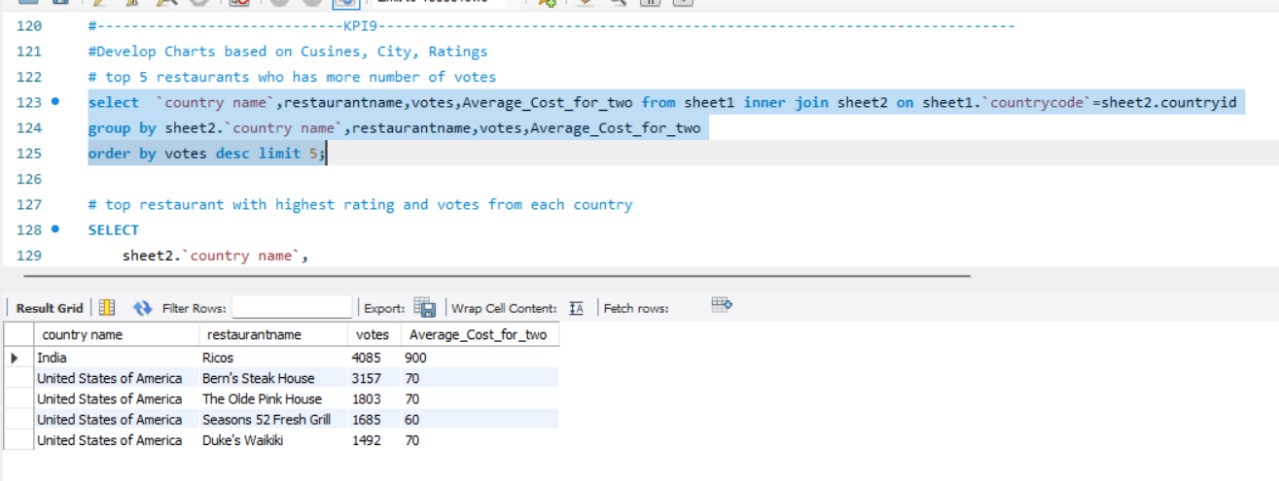
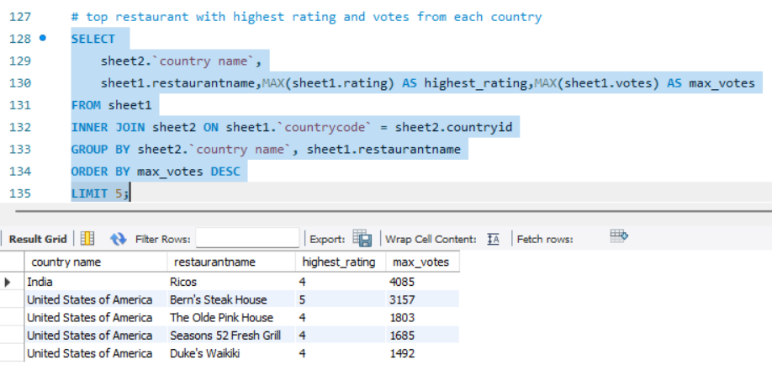
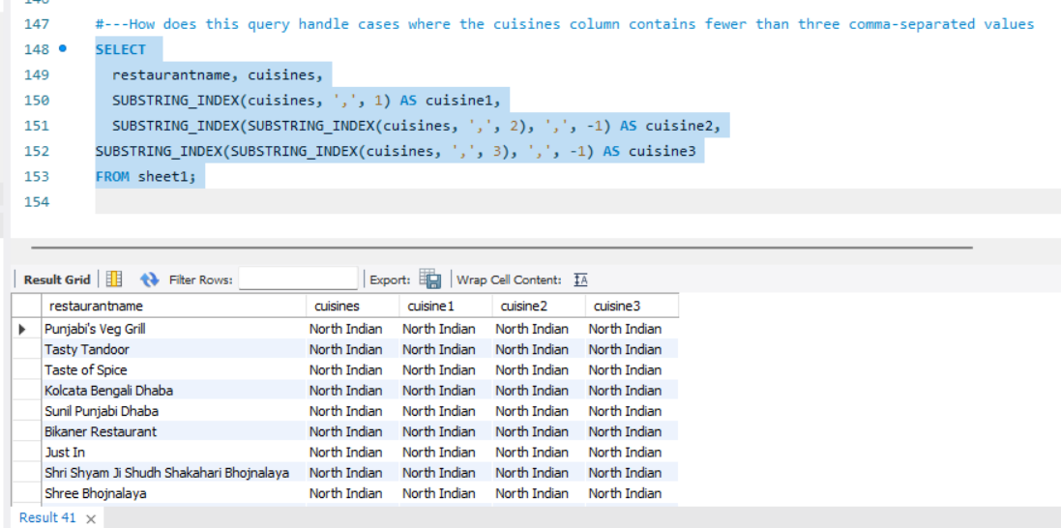

Slide 24
CONCLUSION
There are a total of 9551 restaurants, 8652 are located exclusively in india.
Currently, only 12% of restaurants offer table booking services. Future efforts should focus on increasing this percentage.
Despite the preference for online deliveries among this generation, zomato only provides online delivery facilities for 25% of its listed restaurants, indicating room for improvement.
From 2010 to 2018, zomato has consistently added 1000 restaurants per year. If this trend continues, zomato will surpass 10,000 associated restaurants in the next decade.
Approximately 75% of restaurants have ratings between 3 and 4, which is encouraging. Improving customer reviews and fulfilling their needs can help increase the number of restaurants with ratings between 4 and 5.

Slide 25
THANK YOU

